Slide 1
Selections, Mathematical functions and loops
Object-Oriented Programming (01CT0105)
Dr. Chirag Joshi
Department of ICT
chirag.joshi@marwadieducation.edu.in

Slide 2

Looping
What we will learn
If statement
Two way if statement
Nested if statement
Switch statement
Conditional Expression
While loop
Do-while loop
For loop
Nested loop
Break and continue statement
Common mathematical expression

Slide 3
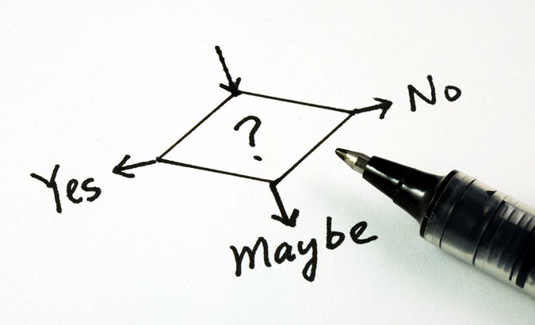

Slide 4
Decision Making
Compiler executes program statements sequentially.
Decision making statements are used to control the flow of program execution.
It allows us to control whether a set of program statement should be executed or not.
It evaluates condition or logical expression first and based on its result (true or false), the control is transferred to the particular statement.
If result is true then it takes one path else it takes another path.
True
condition
False
…
…
…

Slide 5
Decision Making Statements
Commonly used decision making statements are
One way Decision: if (Also known as simple if)
Two way Decision: if…else
Multi way Decision: if…else if…else if…else
Decision within Decision: nested if
Two way Decision: ?: (Conditional Operator)
n-way Decision: switch…case

Slide 6
if
One way Decision

Slide 7
if
if statement is the most simple decision-making statement also known as simple if.
An if statement consists of a boolean expression followed by one or more statements.
If the expression is true, then 'statement-inside' will be executed, otherwise 'statement-inside' is skipped and only 'statement-outside' will be executed.
It is used to decide whether a block of statements will be executed or not i.e if a certain condition is true then a block of statement is executed otherwise not.
condition
False
if(condition)
{
// Statements to execute if condition is true
}
True
statement-inside

Slide 8
Scanner
Scanner is a class in java.util package used for obtaining the input of the primitive types like int, double, etc. and strings. It is the easiest way to read input in a Java program, though not very efficient if you want an input method for scenarios where time is a constraint like in competitive programming.
To create an object of Scanner class, we usually pass the predefined object System.in, which represents the standard input stream. We may pass an object of class File if we want to read input from a file.
To read numerical values of a certain data type XYZ, the function to use is nextXYZ(). For example, to read a value of type short, we can use nextShort()
To read strings, we use nextLine().

Slide 9
Scanner
To read a single character, we use next().charAt(0). next() function returns the next token/word in the input as a string and charAt(0) function returns the first character in that string.
The Scanner class reads an entire line and divides the line into tokens. Tokens are small elements that have some meaning to the Java compiler. For example, Suppose there is an input string: How are you
In this case, the scanner object will read the entire line and divides the string into tokens: “How”, “are” and “you”. The object then iterates over each token and reads each token using its different methods.

Slide 10
WAP to print if a number is positive
import java.util.*;
class MyProgram{
public static void main (String[] args){
int x;
Scanner sc = new Scanner(System.in);
x = sc.nextInt();
if(x > 0){
System.out.println("number is a positive");
}
}

Slide 11
Exercise
Write a program which reads two numbers and based on difference between them prints either of following message DIFFERENCE IS POSITIVE or DIFFERENCE IS NEGATIVE.

Slide 12
WAP to print if a number is odd or even
import java.util.*;
class MyProgram{
public static void main (String[] args){
int x;
Scanner sc = new Scanner(System.in);
x = sc.nextInt();
if( x % 2 == 1 ){
System.out.println("number is a odd");
}
if( x % 2 == 0 ){
System.out.println("number is a even");
}
}

Slide 13
if…else
Two way Decision

Slide 14
If…else
For a simple if, if a condition is true, the compiler executes a block of statements, if condition is false then it doesn’t do anything.
What if we want to do something when the condition is false? if…else is used for the same.
If the 'expression' is true then the 'statement-block-1' will get executed else 'statement-block-2' will be executed.
if(condition)
{
// statement-block-1
// to execute if condition is true
}
else
{
// statement-block-2
// to execute if condition is false
}
True
condition
False
statement-block-1
statement-block-2
…

Slide 15
WAP to print if a number is positive or negative
import java.util.*;
class MyProgram{
public static void main (String[] args){
int x;
Scanner sc = new Scanner(System.in);
x = sc.nextInt();
if (x > 0){
System.out.println("Number is positive");
}//if
else{
System.out.println("Number is negative");
}//else
}//main
}//class

Slide 16
WAP to print if a number is odd or even
import java.util.*;
class MyProgram{
public static void main (String[] args){
int x;
Scanner sc = new Scanner(System.in);
x = sc.nextInt();
if( x % 2 == 1 ){
System.out.println("number is a odd");
}
else{
System.out.println("number is a even");
}
}

Slide 17
Exercise
Any year is entered through the keyboard, write a program to determine whether the year is leap or not.
Write a program to check whether a triangle is valid or not, when the three angles of the triangle are entered through the keyboard. A triangle is valid if the sum of all the three angles is equal to 180 degrees.

Slide 18
if…else if…else
Multi way Decision

Slide 19
if…else if…else
if…else if…else statement is also known as if-else-if ladder which is used for multi way decision making.
It is used when there are more than two different conditions.
It tests conditions in a sequence, from top to bottom.
If first condition is true then the associated block with if statement is executed and rest of the conditions are skipped.
If condition is false then then the next if condition will be tested, if it is true then the associated block is executed and rest of the conditions are skipped. Thus it checks till last condition.
Condition is tested only and only when all previous conditions are false.
The last else is the default block which will be executed if none of the conditions are true.
The last else is not mandatory. If there are no default statements then it can be skipped.
if(condition 1)
{
statement-block1;
}
else if(condition 2)
{
statement-block2;
}
else if(condition 3)
{
statement-block3;
}
else if(condition 4)
{
statement-block4;
}
else
default-statement;

Slide 20
if-else-if ladder
condition1
False
if(condition 1)
{
statement-block1;
}
else if(condition 2)
{
statement-block2;
}
else if(condition 3)
{
statement-block3;
}
else if(condition 4)
{
statement-block4;
}
else
default-statement;
True
condition2
False
…
False
True
condition3
…
True
…
…

Slide 21
WAP to print if a number is zero or positive or negative
import java.util.*;
class MyProgram{
public static void main (String[] args){
int x;
Scanner sc = new Scanner(System.in);
x = sc.nextInt();
if(x > 0){
System.out.println(" number is a positive");
}
else if(x < 0) {
System.out.println(" number is a negative");
}
else{
System.out.println(" number is a zero");
}
}

Slide 22
WAP to print day name from day number
public class Demo {
public static void main(String[] args) {
int d;
Scanner sc = new Scanner(System.in);
d = sc.nextInt();
if (d == 1 ) System.out.println(“Monday”);
else if (d == 2) System.out.println(“Tuesday“);
else if (d == 3) System.out.println(“Wednesday“);
else if (d == 4) System.out.println(“Thursday“);
else if (d == 5) System.out.println(“Friday“);
else if (d == 6) System.out.println(“Saturday“);
else System.out.println(“Sunday“);
}
}

Slide 23
if-else statement
int marks = 65;
if (marks < 60) {
System.out.println("fail");
} else if (marks >= 60 && marks < 80) {
System.out.println("B grade");
} else if (marks >= 80 && marks < 90) {
System.out.println("A grade");
} else if (marks >= 90 && marks < 100) {
System.out.println("A+ grade");
} else {
System.out.println("Invalid!");
}

Slide 24
Nested If
A nested if is an if statement that is the target of another if statement.
Nested if statements mean an if statement inside another if statement.
The statement connected to the nested if statement is only executed when -:
condition of outer if statement is true, and
condition of the nested if statement is also true.
Note: There could be an optional else statement associated with the outer if statement, which is only executed when the condition of the outer if statement is evaluated to be false and in this case, the condition of nested if condition won't be checked at all.
if(condition 1)
{
if(condition 2)
{
nested-block;
}
else
{
nested-block;
}
}//if
else if(condition 3)
{
statement-block3;
}
else(condition 4)
{
statement-block4;
}

Slide 25
Nested If statement
We can also use if/else if statement inside another if/else if statement, this is known as nested if statement.
int username = Integer.parseInt(args[0]);
int password = Integer.parseInt(args[1]);
double balance = 123456.25;
if(username==1234){
if(password==987654){
System.out.println("Your Balance is ="+balance);
}
else{
System.out.println("Password is invalid");
}
}
else{
System.out.println("Username is invalid");
}

Slide 26
Exercise
In a company an employee is paid as under:
If his basic salary is less than Rs. 1500, then HRA = 10% of basic salary and DA = 90% of basic salary.
If his salary is either equal to or above Rs. 1500, then HRA = Rs. 500 and DA = 98% of basic salary.
Employee's salary is input through the keyboard, write a program to find his gross salary.

Slide 27
switch…case
n-way Decision

Slide 28
Switch…case
switch…case is a multi-way decision making statement.
It is similar to if-else-if ladder statement.
It executes one statement from multiple conditions.
switch (expression)
{
case constant 1:
// Statement-1
break;
case constant 2:
// Statement-2
break;
case constant 3:
// Statement-3
break;
default:
// Statement-default
// if none of the above case matches then this block would be executed.
}

Slide 29
Switch…case: WAP to print day based on number entered
switch (d) {
case 1:
System.out.println(“Monday“); break;
case 2:
System.out.println(“Tuesday“); break;
case 3:
System.out.println(“Wednesday“); break;
case 4:
System.out.println(“Thursday“); break;
case 5:
System.out.println(“Friday“); break;
case 6:
System.out.println(“Saturday“); break;
case 7:
System.out.println(“Sunday“); break;
default:
System.out.println(“Invalid Day“);
} //switch
}
}
public class Demo {
public static void main(String[] args){
int d;
Scanner sc= new Scanner(System.in);
d = sc.nextInt();

Slide 30
Switch…case
switch statement executes one statement from multiple conditions. It is like if-else-if ladder statement.
public class SwitchExampleDemo {
public static void main(String[] args)
{
int number = 20;
switch (number) {
case 10:
System.out.println("10");
break;
case 20:
System.out.println("20");
break;
default:
System.out.println("Not 10 or 20");
}
}
}

Slide 31
Exercise
Write a menu driven program that allows user to enters five numbers and then choose between finding the smallest, largest, sum or average. Use switch case to determine what action to take. Provide error message if an invalid choice is entered.

Slide 32
Points to remember for switch…case
The condition in the switch should result in a constant value otherwise it would be invalid.
In some languages, switch statements can be used for integer values only.
Duplicate case values are not allowed.
The value for a case must be of the same data type as the variable in the switch.
The value for a case must be a constant.
variables are not allowed as an argument in switch statement.
The break statement is used inside the switch to terminate a statement sequence.
The break statement is optional, if eliminated, execution will continue on into the next case.
The default statement is optional and can appear anywhere inside the switch block.

Slide 33
Exercise
Write a Java program to get a number from the user and print whether it is positive or negative.
Write a program to find maximum no from given 3 no.
The marks obtained by a student in 5 different subjects are input through the keyboard.
The student gets a division as per the following rules:
Percentage above or equals to 60-first division
Percentage between 50 to 59-second division
Percentage between 40 and 49-Third division
Percentage less than 40-fail
Write a program to calculate the division obtained by the student.
Write a Java program that takes a number from the user and displays the name of the weekday accordingly (For example if user enter 1 program should return Monday) .

Slide 34
Introduction to loop
Repeatedly execute a block of statements

Slide 35
Loop
Sometimes we need to repeat certain actions several times or till the some criteria is satisfied.
Loop constructs are used to iterate a block of statements several times.
Loop constructs repeatedly execute a block of statements for a fixed number of times or till some condition is satisfied
Flowchart of if (true-block executed only once)
Flowchart of while
(true-block executed till condition is true)
condition
False
condition
False
True
True
true-block
true-block

Slide 36
Looping Statements
Following are looping statements in any programming language,
Entry Controlled while, for
Exit Controlled do…while
Unconditional Jump goto (It is advised to never use goto in a program)

Slide 37
while
Entry Controlled Loop

Slide 38
while
while is a entry controlled loop.
It executes a block of statements till the condition is true.
while(condition)
{
// true-block
}
Flowchart of while
(true-block executed till condition is true)
condition
False
int i = 1;
while (i <= 5)
{
System.out.println(i);
i++;
}
True
true-block

Slide 39
While Loop
while loop is used to iterate a part of the program several times. while is entry control loop.
If the number of iteration is not fixed, it is recommended to use while loop.
//code will print 1 to 9
public class WhileLoopDemo {
public static void main(String[] args) {
int number = 1;
while(number < 10) {
System.out.println(number);
number++;
}
}
}

Slide 40
Do-while Loop
do-while loop is executed at least once because condition is checked after loop body.
//code will print 1 to 9
public class DoWhileLoopDemo {
public static void main(String[] args) {
int number = 1;
do {
System.out.println(number);
number++;
}while(number < 10) ;
}
}

Slide 41
WAP to print odd numbers between 1 to n
import java.util.*;
class WhileDemo{
public static void main (String[] args){
int n,i=1;
Scanner sc = new Scanner(System.in);
System.out.print("Enter a number:");
n = sc.nextInt();
while(i <= n){
if(i%2==1)
System.out.println(i);
i++;
}
}}
Output
Enter a number:10 1 3 5 7 9

Slide 42
WAP to print factors of a given number
import java.util.*;
class WhileDemo{
public static void main (String[] args){
int i=1,n;
Scanner sc = new Scanner(System.in);
System.out.print("Enter a Number:");
n = sc.nextInt();
System.out.print(" Factors:");
while(i <= n){
if(n%i == 0)
System.out.print(i +",");
i++;
}
}}
Output
Enter a Number:25 Factors:1,5,25

Slide 43
Exercise:while
WAP to print multiplication table using while loop
Write a program that calculates and prints the sum of the even integers from 1 to 10.

Slide 44
for(;;)
Entry Controlled Loop

Slide 45
for
for is an entry controlled loop
Statements inside the body of for are repeatedly executed till the condition is true
The initialization statement is executed only once, at the beginning of the loop.
Then, the condition is evaluated.
If the condition is true, statements inside the body of for loop are executed
If the condition is false, the for loop is terminated.
Then, increment / decrement statement is executed
Again the condition is evaluated and so on so forth till the condition is true.
for (initialization; condition; increment /decrement)
{
// statements
}
int i = 1;
while (i <= 5) {
System.out.print("Hell o World!");
i++;
}
for(i=1; i <= 5; i++)
{
System.out.print("Hello World!");
}

Slide 46
For Loop
for loop is used to iterate a part of the program several times.
If the number of iteration is fixed, it is recommended to use for loop.
//code will print 1 to 9
public class ForLoopDemo {
public static void main(String[] args)
{
for(int number=1;number<10;number++)
{
System.out.println(number);
}
}
}

Slide 47
WAP to print odd numbers between 1 to n
import java.util.*;
class MyProgram{
public static void main (String[] args){
int i=1;
Scanner sc = new Scanner(System.in);
n = sc.nextInt();
for(i=1; i<=n; i++) {
if(i%2==1)
System.out.println(i);
}//for
}//
}

Slide 48
WAP to print factors of a given number
import java.util.*;
class MyProgram{
public static void main (String[] args){
int i=1;
Scanner sc = new Scanner(System.in);
n = sc.nextInt();
for(i=1; i<=n; i++){
if(n%i == 0)
System.out.println(i);
}
}
}

Slide 49
Exercise: for
Write a program to print average of n numbers.
Write a program that calculates and prints the sum of the even integers from 1 to 10.

Slide 50
do…while
Exit Controlled Loop

Slide 51
do…while
do…while is an exit controlled loop.
Statements inside the body of do…while are repeatedly executed till the condition is true.
while loop executes zero or more times, do…while loop executes one or more times.
do
{
// true-block
}
while(condition) ;
Flowchart of while
Flowchart of do…while
condition
False
true-block
True
condition
true-block
True
False

Slide 52
WAP to print 1 to 10 using do-while loop
import java.util.*;
class MyProgram{
public static void main (String[] args){
int i=1;
do{
System.out.println(i);
i++;
}while(i <= 10);
}
}

Slide 53
continue
Skip the statement in the iteration

Slide 54
continue
Sometimes, it is required to skip the remaining statements in the loop and continue with the next iteration.
continue statement is used to skip remaining statements in the loop.
continue is keyword.

Slide 55
WAP to calculate the sum of positive numbers.
import java.util.*;
class ContinueDemo{
public static void main(String[] args) {
int a,n,sum=0;
Scanner sc = new Scanner(System.in);
n = sc.nextInt();
for(int i=0;i<n;i++){
a = sc.nextInt();
if(a<0){
continue;
System.out.println("a="+a);//error:unreachable statement
}//if
sum=sum+a;
}//for
System.out.println("sum="+sum);
}
}

Slide 56
break
Early exit from the loop

Slide 57
break
Sometimes, it is required to early exit the loop as soon as some situation occurs.
E.g. searching a particular number in a set of 100 numbers. As soon as the number is found it is desirable to terminate the loop.
break statement is used to jump out of a loop.
break statement provides an early exit from for, while, do…while and switch constructs.
break causes exit from the innermost loop or switch.
break is keyword.

Slide 58
WAP to calculate the sum of given numbers. User will enter -1 to terminate.
import java.util.*;
class BreakDemo{
public static void main (String[] args){
int a,sum=0;
System.out.println("enter numbers_ enter -1 to break");
Scanner sc = new Scanner(System.in);
while(true){
a = sc.nextInt();
if(a==-1)
break;
sum=sum+a;
}//while
System.out.println("sum="+sum);
}
}

Slide 59
Types of loops
Entry Control Loop
Entry Control Loop
Exit Control Loop
Virtual Loop
int i=1;
while(i<=10)
{
i++;
}
int i;
for(i=1;i<=10;i++)
{
i++;
}
int i=1;
do
{
i++;
}
while(i<=10);
int i=1;
p: i++;
if(i<=10)
goto p;
condition
False
Label
Statement
Loop Body
True
True
condition
True
condition
Loop Body
False
goto
label
False

Slide 60
nested loop
loop within a loop

Slide 61
WAP to print given pattern (nested loop)
*
**
***
****
*****
class PatternDemo{
public static void main(String[] args) {
int n=5;
for(int i=1;i<=n;i++){
for(int j=1;j<=i;j++){
System.out.print("*");
}//for j
System.out.println();
}//outer for i
}
}

Slide 62
WAP to print given pattern (nested loop)
1
1 2
1 2 3
1 2 3 4
1 2 3 4 5
class PatternDemo{
public static void main(String[] args) {
int n=5;
for(int i=1;i<=n;i++){
for(int j=1;j<=i;j++){
System.out.print(j+"\t");
}//for j
System.out.println();
}//outer for i
}
}

Slide 63
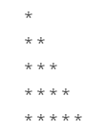
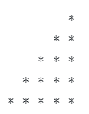
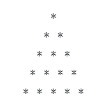
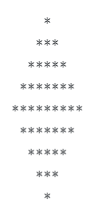
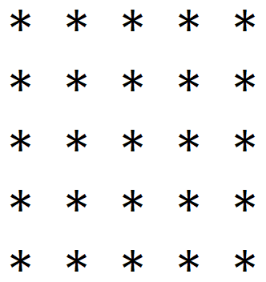
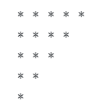
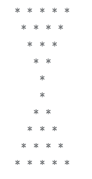
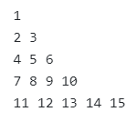
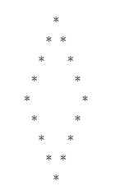
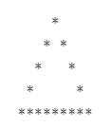
Programs to perform (Looping Statements)
Write a program to print first n odd numbers.
Write a program to check that the given number is prime or not.
Write a program to draw given patterns,

Slide 64

Mathematical functions

Slide 65
Math class
The Java Math class provides more advanced mathematical calculations other than arithmetic operator.
The java.lang.Math class contains methods which performs basic numeric operations such as the elementary exponential, logarithm, square root, and trigonometric functions.
All the methods of class Math are static.
Fields :
Math class comes with two important static fields
E : returns double value of Euler's number (i.e 2.718281828459045).
PI : returns double value of PI (i.e. 3.141592653589793).

Slide 66
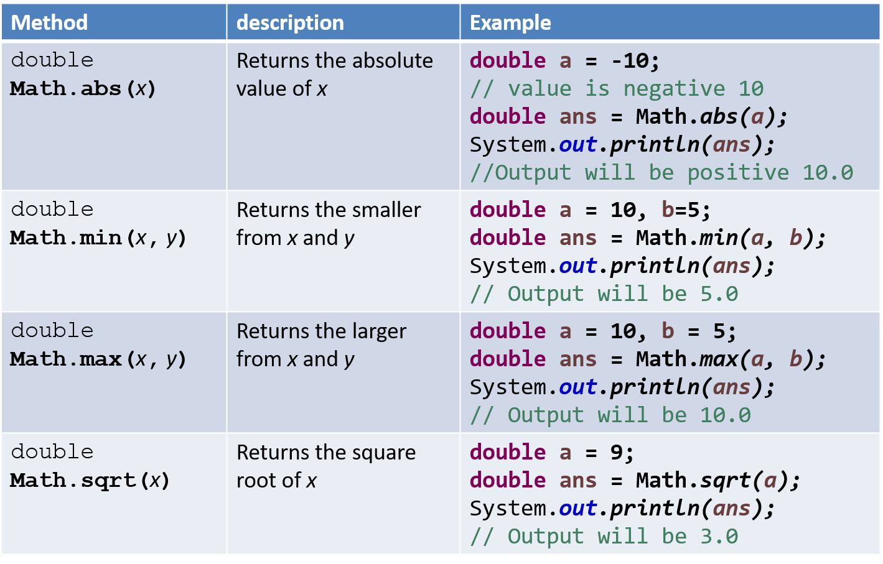
Methods of class Math

Slide 67
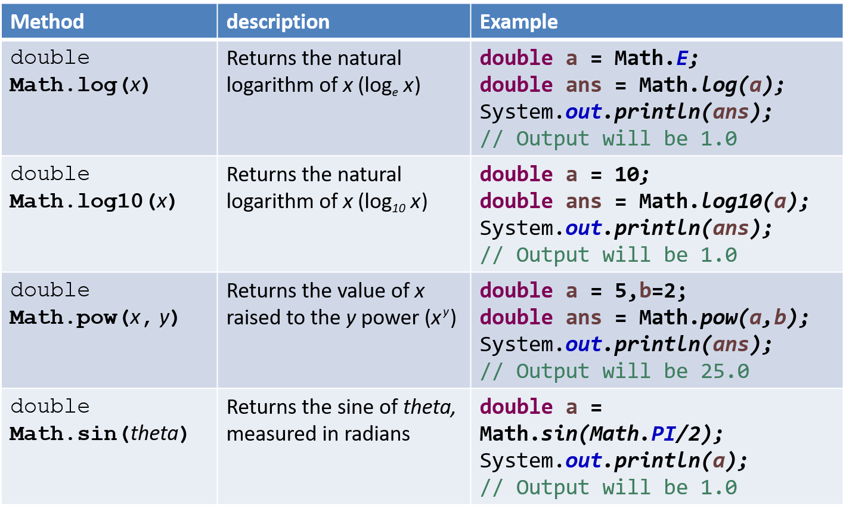
Methods of class Math (Cont.)

Slide 68
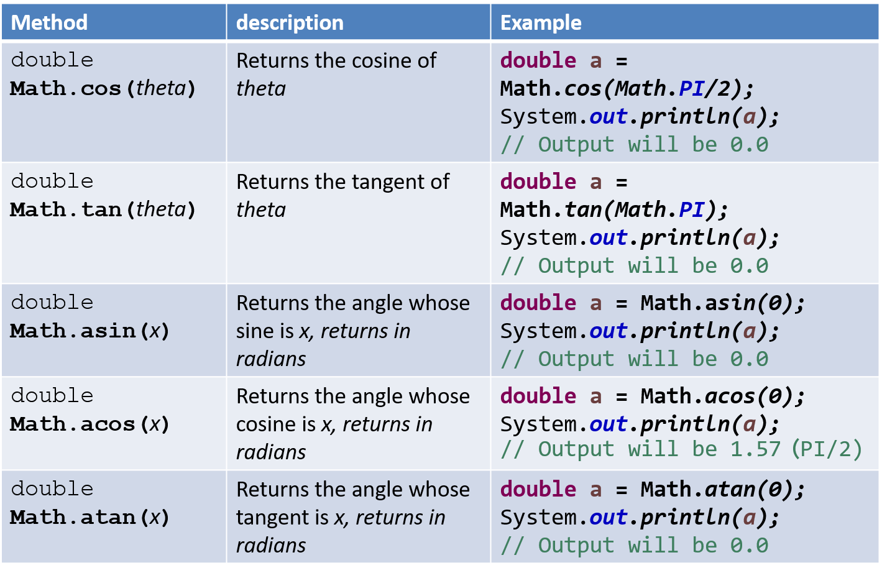
Methods of class Math (Cont.)

Slide 69
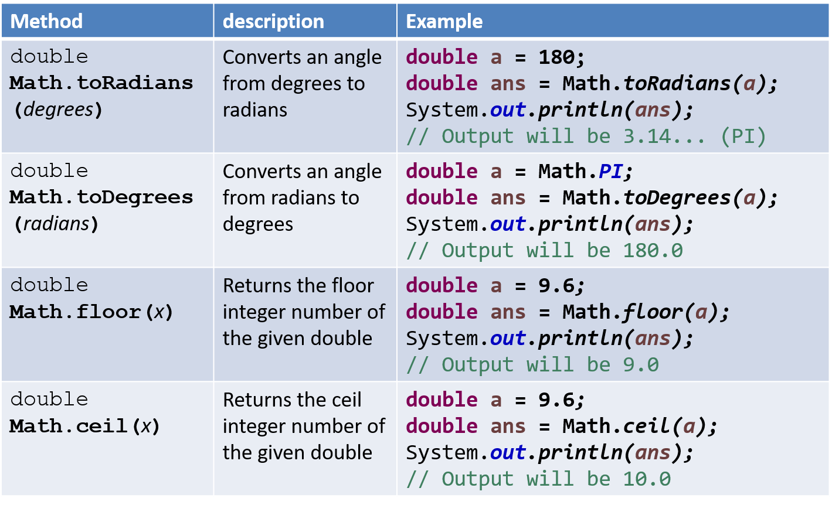
Methods of class Math (Cont.)

Slide 70
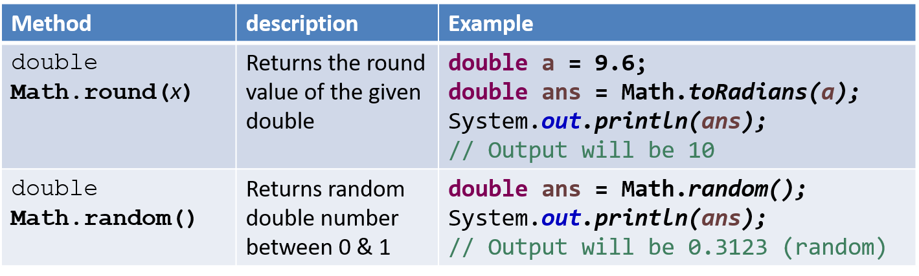
Methods of class Math (Cont.)

Slide 71
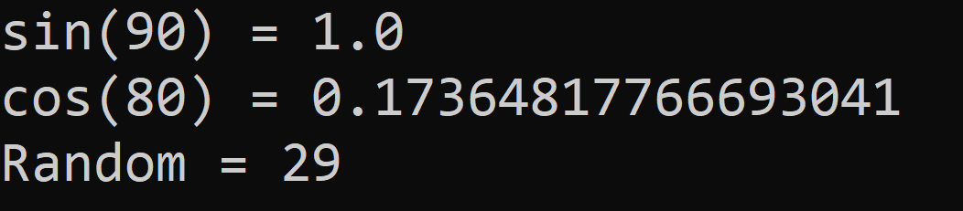
Math Example
public class MathDemo {
public static void main(String[] args) {
double sinValue = Math.sin(Math.PI / 2);
double cosValue = Math.cos(Math.toRadians(80));
int randomNumber = (int)(Math.random() * 100);
// values in Math class must be given in Radians
// (not in degree)
System.out.println("sin(90) = " + sinValue);
System.out.println("cos(80) = " + cosValue);
System.out.println("Random = " + randomNumber);
}
}

Slide 72
Thank You

